Slide 1
How Carle Health’s Automated Population Health Workflows Improve Staff Capacity
Kristin Kohl, MSN, Director of Population Health Clinical Improvement, Carle Health
Jessica Scruton BSN, RN, CCM-R, VP of Clinical Services, Lightbeam Health Solutions
February 22, 2023

Slide 2
Introductions & Learning Objectives
Notes:
Jessica

Slide 3
Agenda
Intros & Learning Objectives
Introduction to Lightbeam’s Deviceless Remote Patient Monitoring & Licensed Clinical Services
Carle Health’s Vision for Population Health
Strategy & Workflow
Utilization & Impact
What’s Next?
Q&A
Notes:
Jessica

Slide 4
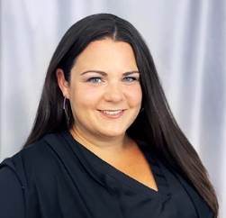
Learning Objectives
Explain the technological and staffing barriers to scaling population health initiatives and strategies to overcome them
Describe how combining technology and care managers enables wide patient reach and efficient issue resolution
Identify the ways in which real-time alert data are enabling top-of-license care management
Kristin Kohl, MSN
Director of Population Health Clinical Improvement, Carle Health
Jessica Scruton, BSN, RN, CCM-R
VP of Clinical Services, Lightbeam Health Solutions
Notes:
Jessica
This webinar will describe Carle Health's process for creating workflows that combine automated technology and staff that can be easily scaled up or down as patient population sizes change; ensuring patient needs are met and health outcomes are improved.

Slide 5
Current Population Health Landscape
Notes:
Jessica

Slide 6
Market Trends: Population Health
Expanding volume of value-based contracts Increasing exposure of downside risk putting focus on cost and utilization
Nursing Staff shortages/burnout
Aggressive quality metric benchmarks
Growing emphasis on health equity
%
Notes:
Jessica
Why are we here today? As provider organizations across the U.S are tasked with managing larger value-based care populations but less staff resources to manually support them, population health leaders are faced with a question of how to grow care management capacity in a way that is financially sustainable.

Slide 7
Common Challenges Across Population Health
Imprecise Risk Identification
Leveraging community-level data sources to assess health equity
Need for patient-level data to holistically assess an individual's clinical and SDoH risk factors
Disconnected SDoH Strategy
Many assess social determinants of health reactively and infrequently
Need for proactive, ongoing assessments and seamless connections to resources
Missing the Most Vulnerable
Relying on face-to-face visits
App, portals, and telehealth struggle to engage patients who need the extra support most
Staffing Capacity Challenges
Missed opportunities to close gaps and proactively monitor rising-risk populations
Not scaling resources with population's needs
Balance Quality Metrics, Utilization, and Satisfaction
Utilization & satisfaction metrics require more holistic approaches
Notes:
Jessica
With larger value-based care populations but less staff resources to manually support them, population health leaders are faced with a question of how to enable financially sustainable care management.

Slide 8
Healthcare Industry Challenges & Impacts
Industry Challenges
Resulting In
Physicians are juggling multiple payer contracts and incentives​
Care gap and utilization management reports are usually sent quarterly, with a 60-90-day lag that creates challenges in managing patients​
Gap reports are not prioritized or aligned to optimize incentive payouts, which discourages proactive management​
Poor payer/provider alignment​
Missed patient engagement opportunities​
Decreased quality and outcome performance​
Notes:
Jessica

Slide 9
Introduction to Lightbeam’s Deviceless RPM (CareSignal) & Licensed Clinical Services (LCS) Team
Notes:
Jessica

Slide 10
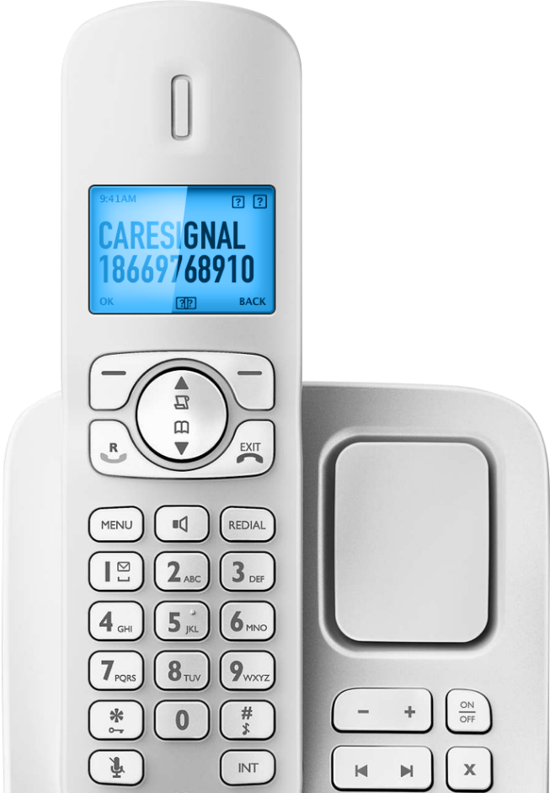
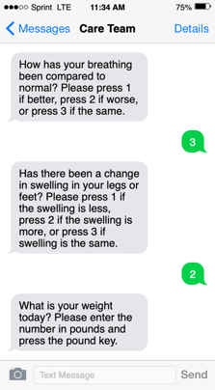
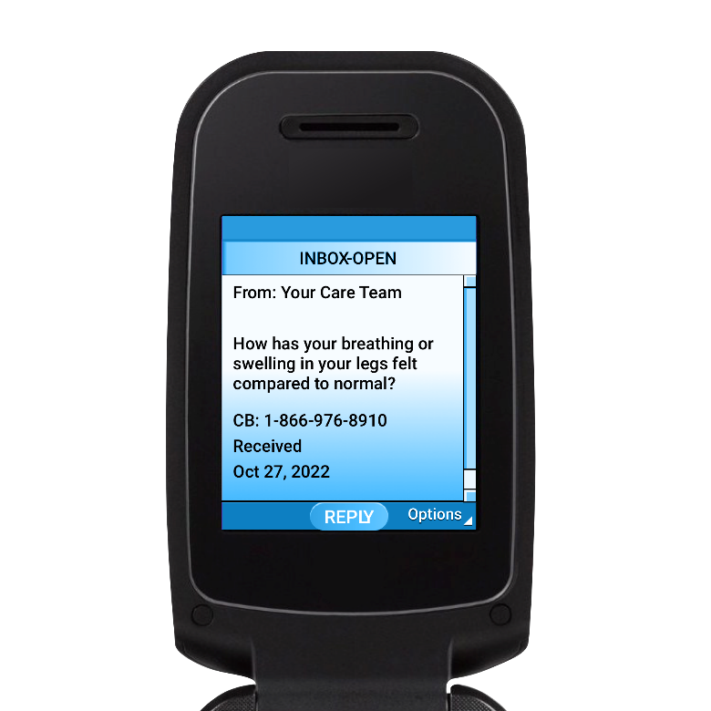
Deviceless Remote Patient Monitoring Affordable | Accessible | Scalable
No new devices required
No apps, downloads, or passwords
Accessible for all patients
Promote & elevate health equity
Clinically validated
13+ Peer reviewed publications
30 Programs | One Portfolio
Pre-built & evidence-based
Engagement powered by AI
Predict & prevent drop-off
White-labeled for patient/member
High-quality, credible experience
Notes:
Jessica

Slide 11
CareSignal Portfolio & Results
30+ Evidence-Based Programs | One Portfolio
Chronic Conditions
Behavioral Health
Specialty Support
Post Discharge
Care Coordination
Heart Failure
COPD
Diabetes
Hypertension
Asthma
Depression
Anxiety
Substance Use
Opioid Management
Caregiver Support
SDoH
Maternal Health
Dialysis
Surgery
Vital Signs
Pneumonia
Post Discharge
Screening Reminders
Appointment Reminders
Referral
General Programs
COVID Suite
Influenza
Fall Risk
Wellness
Medication Adherence
HIV/AIDS
General Medical
13 Publications
in Peer-Reviewed Medical Journals
62% decrease
in hospitalizations
for patients with COPD
46% decrease in CHF ED visits
1.15% drop in HbA1c
over 4 months
50% improvement in blood pressure control over 12 weeks
28% drop in PHQ-9
for patients with
depression
>2.1x increase in follow-up appointment adherence
Notes:
Jessica

Slide 12
Improve Equitable Access to Care with Appropriate Tech
Familiar technology builds trust, patients engage with systems they trust and can access
Notes:
Jessica
Key Takeaway: MA Patients Aged 80+ Prefer Phone Calls to Text
Why it matters: Leveraging patients’ familiar personal phones with text or phone call options builds trust and encourages long-term engagement

Slide 13
Lightbeam Clinical Services Provides a Dedicated Clinical Team
LCS offers staffing augmentation and patient engagement programs designed to work under the general supervision of the partner organization’s providers
Notes:
Jessica
Our clinical staff:
Are licensed in the state in which the patient resides
Are experienced nursing professionals
Adhere to a strict scope of practice
LB LCS was borne from this. We’re seeing patients that need to be managed with a CMS reimbursable charge. So you’ll get paid by CMS and get better visibility into status of high risk patients. We can help increase you AWV and manage TOC for you in addition to CCM.

Slide 14
Hybrid Approach
MULTIPLE CONDITIONS
ACUTE PATIENTS WITH TIME LIMITED NEEDS
PATIENTS WITH SINGLE CHRONIC CONDITION
WELLNESS SUPPORT FOR HEALTHY PATIENTS
MULTIPLE CONDITIONS
ACUTE PATIENTS WITH TIME LIMITED NEEDS
PATIENTS WITH SINGLE CHRONIC CONDITION
WELLNESS SUPPORT FOR HEALTHY PATIENTS
Carle manages CCM patients
LCS manages thousands of rising-risk patients
AWV, RPM, TOC, CCM
AWV, RPM, TOC
LIGHTBEAM CLINICAL SERVICES
AWV, RPM
AWV
Notes:
Jessica

Slide 15
LCS Delivers Outcomes
Clients utilizing Lightbeam Clinical Services achieve significant results:
AWV completion rates (50%) more than double industry average (24%)
Over $50M in generated FFS revenue in 2021
10x increase in Care Manager efficiency (100 →1000 patients)
Notes:
Jessica
Industry average completion rate for AWVs is just 24% - Lightbeam clients achieve an average of nearly 50%

Slide 16
Population Health Enablement Workflow
Jvion
Predictive analytics surface top health inequities and readmission risk
Lightbeam
Identifies cohort of target patients for CareSignal
CareSignal Engagement Specialists
Enroll patients via text, email, mailers, and direct phone calls
Patients
Answer automated SMS and phone call prompts, sending in clinically-relevant data
Deviceless RPM
Categorizes at-risk patients and triggers alerts in real-time
LCS
Care Managers monitor dashboard and follow standard operating procedures
Providers
Receive escalations, only as needed
Notes:
Jessica

Slide 17
Partnership Overview & Workflow
Notes:
Kristin

Slide 18
Carle Health System
Based in Urbana, IL, Carle Health is an integrated System of healthcare services, including
Five hospitals with over 800 beds
Over 1,000 providers within multi-specialty physician groups
Carle Illinois College of Medicine
The Stephens Family Clinical Research Institute.
Health Plans: Health Alliance and FirstCarolina Care
Notes:
Kristin
Carle joined the Stratum Med ACO, a large collaborative ACO, in July of 2019. Carle Health has approximately 20,900 attributed ACO lives within three main regions – Champaign/Urbana, Bloomington/Normal and Richland.

Slide 19
Stratum Med ACO
The Stratum Med ACO was formed in July of 2019 as a large collaborative ACO to shift the focus from pay for performance to a value-based care system.
The following 11 provider groups participate in this ACO and are responsible for around 100,000 Medicare lives
Christie Clinic
Carle/Carle Hoopeston
Carle Richland Memorial Hospital
Carle BroMenn
Mankato
Iowa Clinic
McFarland Clinic
Confluence
Jefferson City Medical Group
Union Health
Hutchinson Clinic
Notes:
Kristin

Slide 20
Vertically Integrated Network: Payer-Provider Collaboration
Shared Population: Carle Health patients and Health Alliance members
Identified & engaged members focus on care coordination, education, setting personal goals & self-management skills.
Notes:
Kristin

Slide 21
Enrollment Strategy
Recurring population identification using:
Epic chronic condition registries
Post-discharge list
Focus Populations:
Medicare ACO attributed patients, Health Alliance members
Patients with CHF, COPD, Hypertension
Patients recently discharged (General-medical)
Notes:
Kristin
Who is currently eligible for RPM?
Patients over 18 years old with Carle Primary Care Physicians
Health Alliance launched on 3/15/2022 for members in the CU Region
Medicare ACO launched on 7/11/2022 for attributed patients in all Carle Regions We started with 5 buckets of patients
Congestive Heart Failure
COPD
Hypertension
Asthma (Health Alliance only)
Post-Discharge from inpatient or the emergency department

Slide 22
Aligned with Value-based Care Priorities
Reduce Avoidable Utilization & Costs
30-day readmission (Post-discharge)
Proactive monitoring of high-cost conditions (CHF, COPD)
Improving Quality
Control of chronic conditions: (Hypertension, COPD, CHF)
Patient Satisfaction
Offer patients additional support and improves communication with their care team
Notes:
Kristin

Slide 23
Automated Enrollment Pathway
Recognized a need for recurring patient lists for enrollment in Deviceless RPM programs
Carle sends CareSignal an automated daily feed of discharge patients eligible for post-discharge follow-up
CareSignal team enrolls eligible patients each day on behalf of Carle
Notes:
Kristin
Automated Daily list pulled from Epic sent over SFTP to CS update
Escalation pathway within application
Takes out guess-work (e.g., moving patients between providers, adding them to programs based on acuity).

Slide 24
Enable Shift from Reactive to Proactive Care
Before Deviceless RPM:
After Deviceless RPM
No RPM program
Referrals based on seeing patients in office
More reactive
Manual process of moving patients between providers, adding them to programs based on acuity
Automated assignment to programs
Proactive
Team dedicated to enrollment
Ability to engage more patients and catch issues before patients end up in the ED
Notes:
Kristin

Slide 25
Congestive Heart Failure
Congestive Heart Failure:
No Alert
Congestive Heart Failure:
Alert Triggered
Are you breathing better, significantly worse or the same compared to normal? If better, please press 1. If significantly worse, please press 2. If the same as normal, please press 3.
2
Inclusion Criteria: Diagnosis
Have you completed your walking program today? Please reply yes or no
Alert Notifications:
Worsening breathing
Worsening swelling
Excessive weight gain
Alert
Triggered
1
3
Thanks for letting us know. If you want to be connected with [Provider name], you can press 1 now and we can try to connect you. If you feel that this is an emergency, please hang up and dial 911.
Has there been any change in the swelling in your legs or feet from what you are used to? If better, please press 1. If significantly worse, please press 2.
1
Auto
Connect
Notes:
Kristin

Slide 26
Utilization & Outcomes
Notes:
Jessica

Slide 27
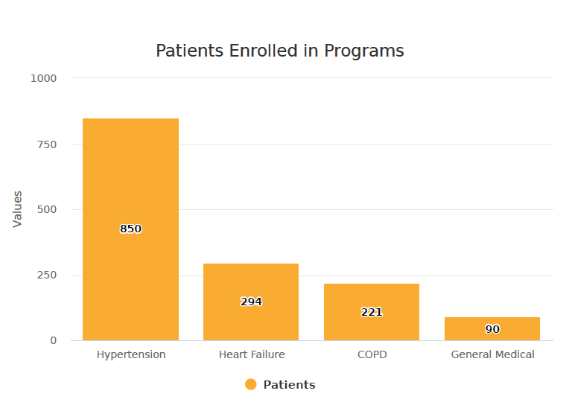
Utilization Across Multiple Chronic Conditions
Conditions:
COPD
CHF
Hypertension
Post-Discharge (General Medical)
Notes:
Jessica

Slide 28
Scaling Engagement to Thousands of Patients
1,341 Patients Enrolled
1,350 Proactive Alerts Triggered
45,000
Total Automated Touches
3% Average Alert Rate
28,000
Total Automated Text Messages
8hr Average Alert Response
17,000 Total Automated Phone Calls
07/20/22- 01/04/23
1,341
Patients enrolled
45,000
Automated Touches
1,350
Proactive Alerts Triggered
28,000 Texts
3% Alert Rate
17,000 Calls
8hr Average alert response
Notes:
Jessica

Slide 29
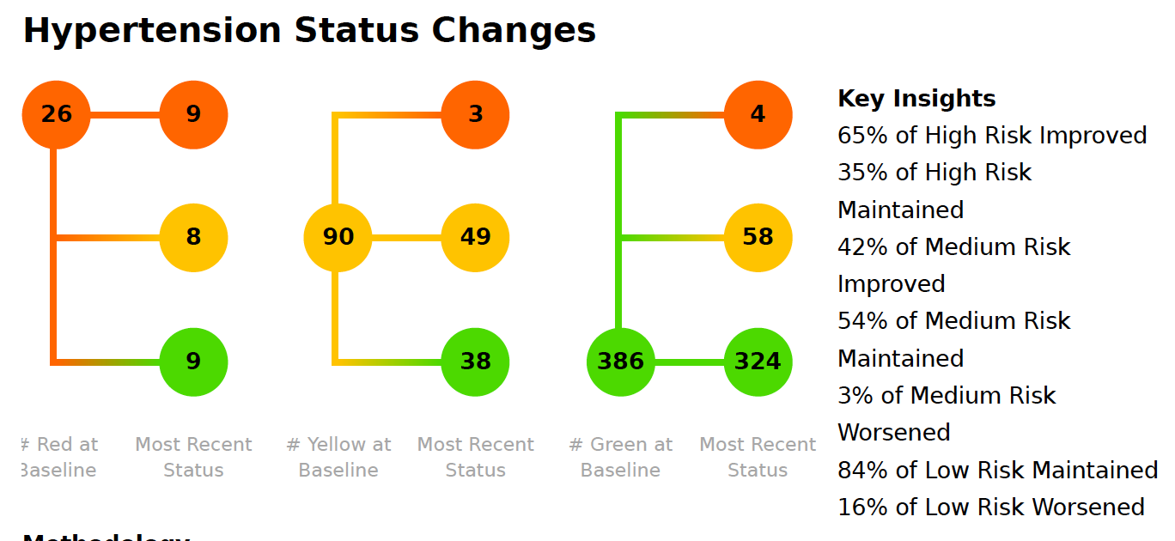
Lowering Risk Across the Continuum
12.69 mmHg drop in avg. sBP from baseline for high-risk hypertension members >160 sBP
Notes:
Jessica

Slide 30
Scaling Staff Resources with LCS
Add Licensed FTE as Needed
(1.0 → 1.5 FTE)
Plug into Existing Ecosystem
Fast onboarding
Follow existing protocols & workflows
No client management oversight required
Impactful
Dedicated to one task (managing alerts is sole responsibility. Enables timely response for patients.
Cost-effective
Reaching 16x More Patients
Before Deviceless RPM & LCS
1 : 60
After Deviceless RPM & LCS
1 : 1,000+
Notes:
Kristin

Slide 31
Automated Pathways Improve Care Team Efficiency
Patient reports symptom or value that is out of range
Alerts fire to dedicated LCS RN Care Manager for follow up
Emergent coordination of care​, escalate to provider or call 911
Assessment form automatically adjusts to populate questions relevant to the patient’s symptoms and alerts
RN calls, has holistic discussion to uncover needs, discuss symptoms, medication compliance, provide education
Refer patient to social work, etc, based on additional uncovered needs
Notes:
Kristin
HTN alert if systolic or dyostolic out of range
LCS RN receives alert and calls patient
visibly, audibly stable, fork 1: non-emergent coordination of care
Talk through BP readings, education, medicine compliance, assessment triage workflow
Based on type of alert that comes- assessment automatically adjusts to populate questions relevant to the patient’s symptoms and alerts (more efficiently go through assessment) efficient
If bad: escalate to care manager/provider within Carle
Fork 2: Emergent coordination of care
Follow emergency protocol, calling 911, etc.
After VCN
Provider pathways built, streamlined (this patient this need goes to CCM, or social work). Decrease asks and staff resources. Defining pathways- SOP questions asked by the VCN team (different for different conditions). Pathway for patient determined by alert, (education, can’t afford meds)
Nurse is first point of contact. Has holistic conversation with patient and uncovers SDOH needs (e.g.,)

Slide 32
Strategies to Improve Participation
Engagement
White-labeled: comes from trusted familiar name (Carle)
Patient Preference
Patient uses existing phone (choose text or call)
Seamless for the patient
Relevant
Specific to patient’s condition
Notes:
Kristin

Slide 33
Messages have improved communication and patient satisfaction with care
Care Satisfaction: You are getting the best possible care from Carle.
N = 604
Average = 7.84
Improved Communication: These messages have improved your communication with Carle.
N = 578
Average = 7.71
1 - Strongly Disagree
Strongly Agree - 9
1 - Strongly Disagree
Strongly Agree - 9
Notes:
Kristin

Slide 34
Patient Quotes
Timely Care
“My doctor is aware of my health, and I know that someone is watching my entries for possible negative trending.”
Convenient for Patients
“Easy to take my readings and to send them....would not change a thing.”
Patient Self-Management
“They keep me checking blood pressure and hold me accountable.”
Notes:
Kristin

Slide 35
Patient Story
Patient enrolled in CareSignal’s Post-Discharge program “general medical”
Patient reported new symptom, triggering a CareSignal alert
LCS Care Manager called to follow-up on alert within hours
Patient described a hole in ankle she believed was a necrotic spider bite for several months
Care Manager recommended patient get a wound consult
Patient had vascular compromise/abscess
Outcome – all healed and regained full functionality
Notes:
Kristin

Slide 36
What’s Next?
Notes:
Kristin
Expanding to additional programs such as Diabetes

Slide 37
Q&A
Connect with the Lightbeam team to learn more about Deviceless RPM and LCS.
Use your phone's native camera app to scan the QR code and easily request more information.
Notes:
Kristin

